Slide 1
OVERVIEW OF FRACTALS
(Practical Approach)

Slide 2
PROPERTIES

Slide 3
1. Self similarity
Part is similar to whole
2. Scaling
Features at one spatial resolution are related at other spatial resolutions
3. Bounded infinity
Fractal object can be represented using recursive function
F(x) , F(F(x)), F(F(x)) , F(F(F(x)))…
4. Fraction dimension
D=log_{r}m r: Reduction factor, m: Number of parts

Slide 4
SELF SIMILARITY

Slide 5
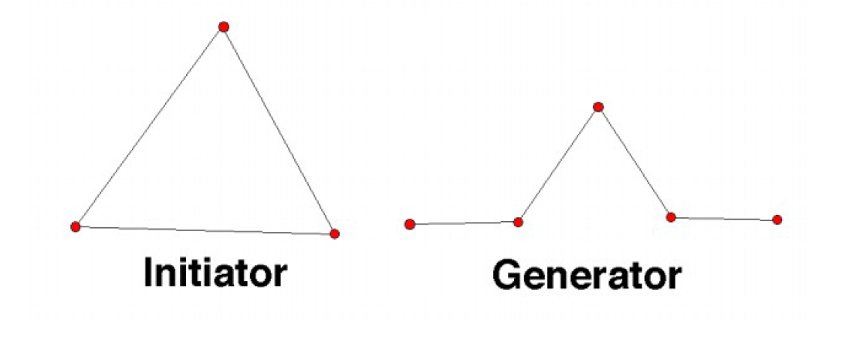
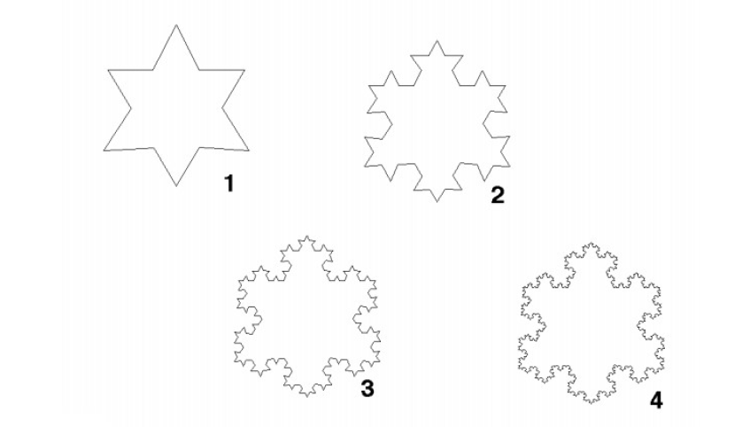
Koch Snowflake

Slide 6
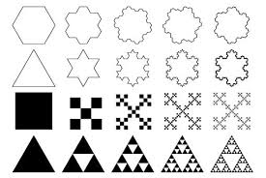

Slide 7
NATURAL EXAMPLE

Slide 8
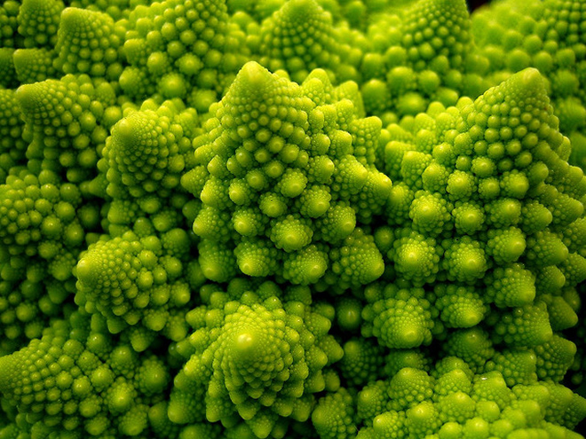
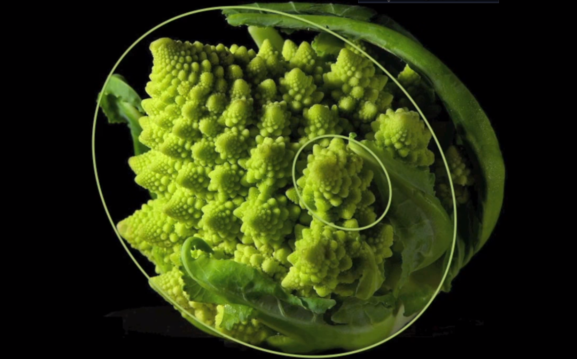
BROCCOLI

Slide 9
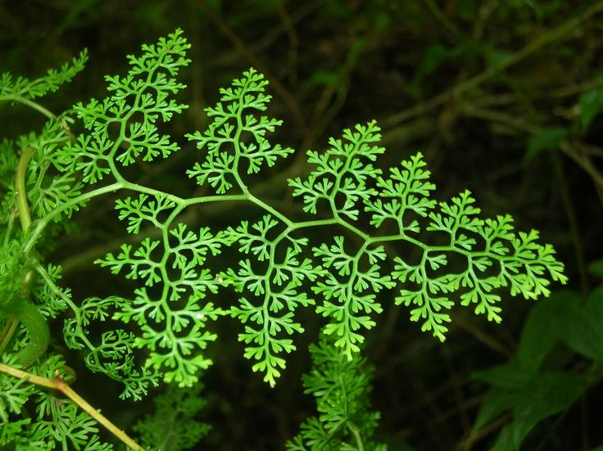
LEAF

Slide 10
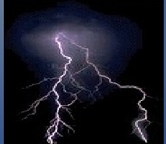
LIGHTNING

Slide 11
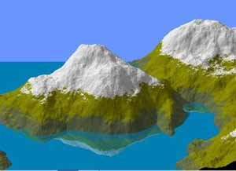
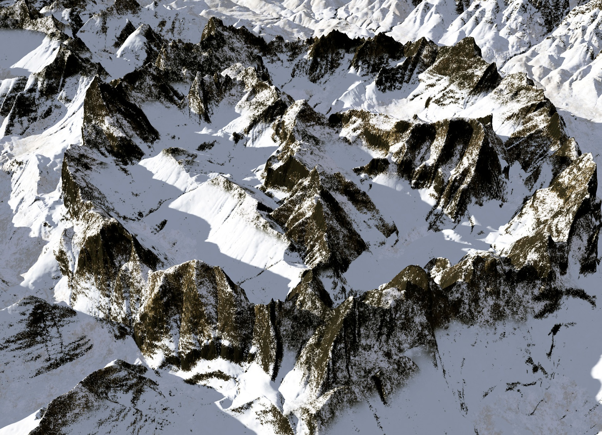
MOUNTAIN

Slide 12
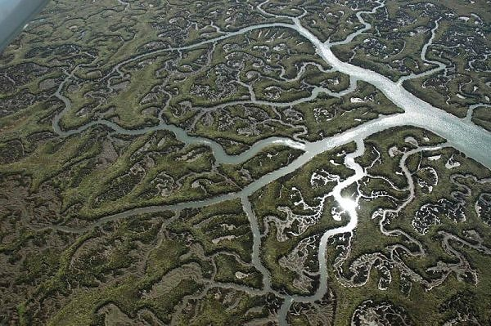
LANDSCAPE

Slide 13
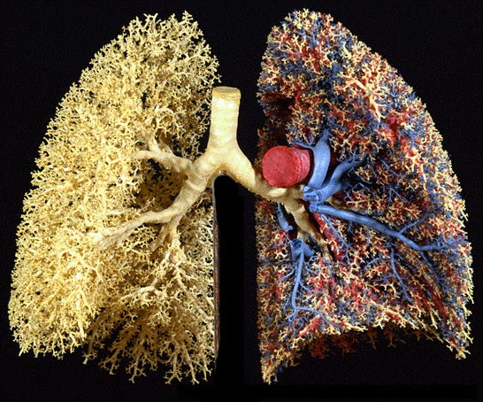
HUMAN LUNGS

Slide 14
COMPUTER GENERATED FRACTALS

Slide 15
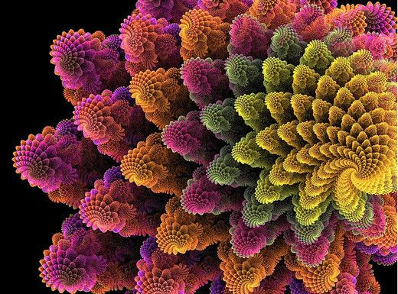

Slide 16
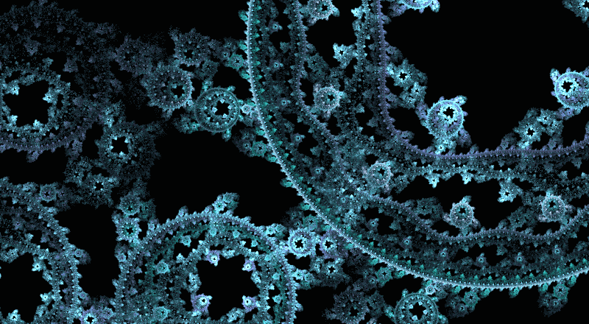

Slide 17
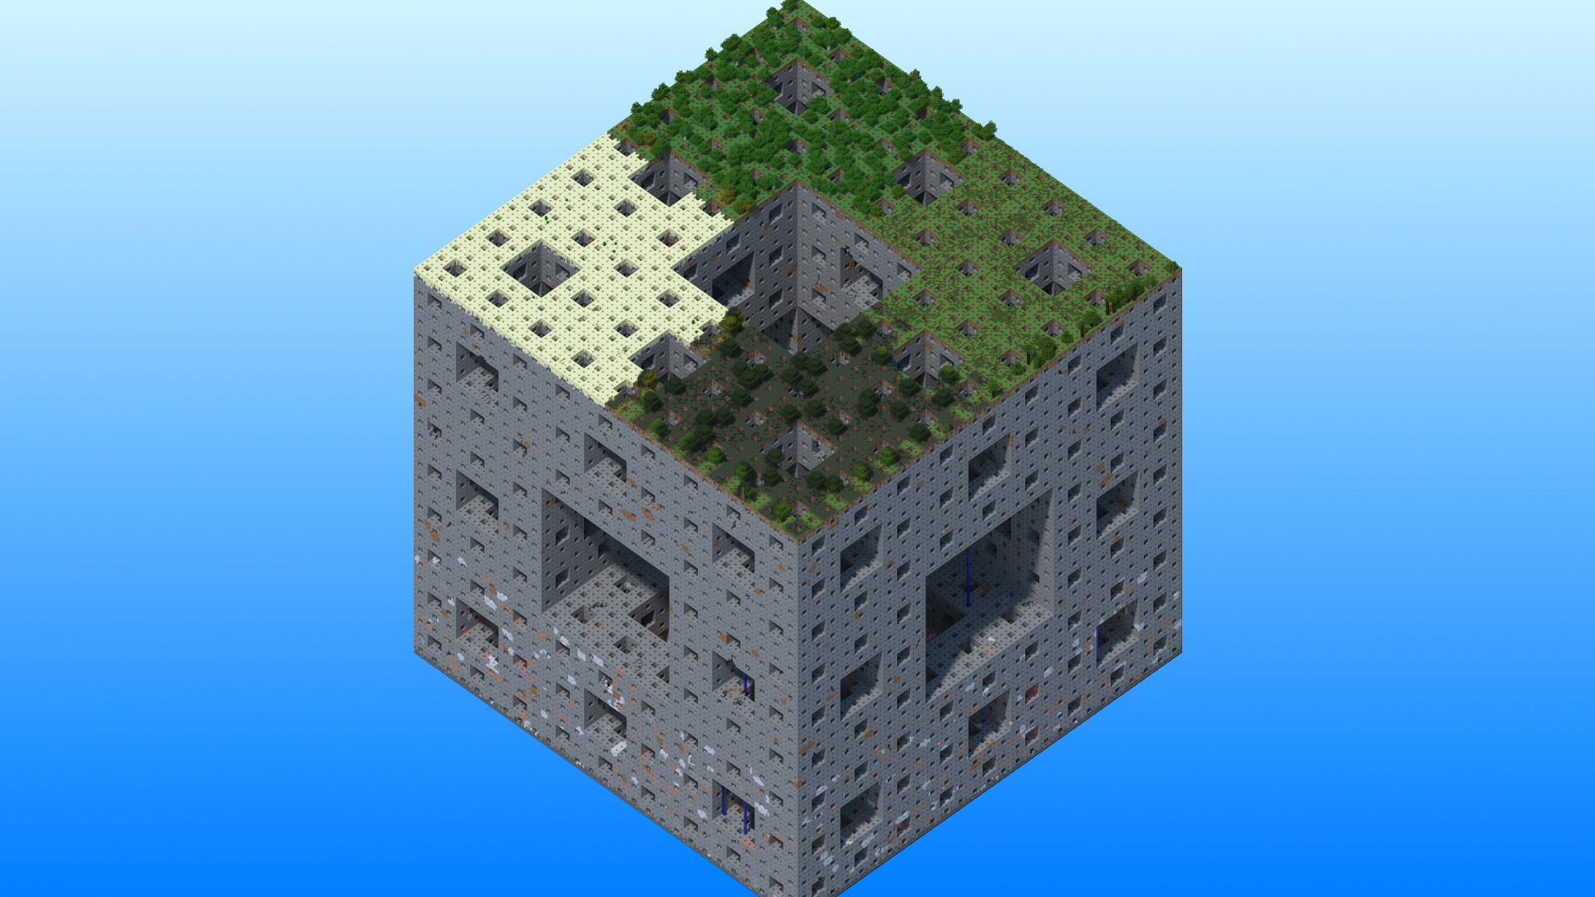
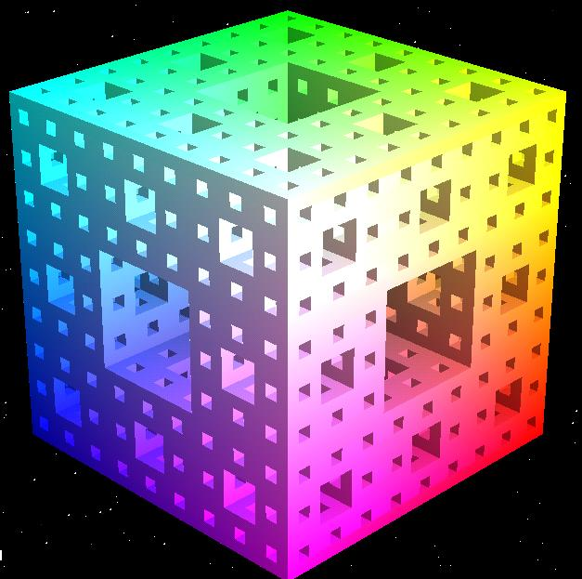

Slide 18
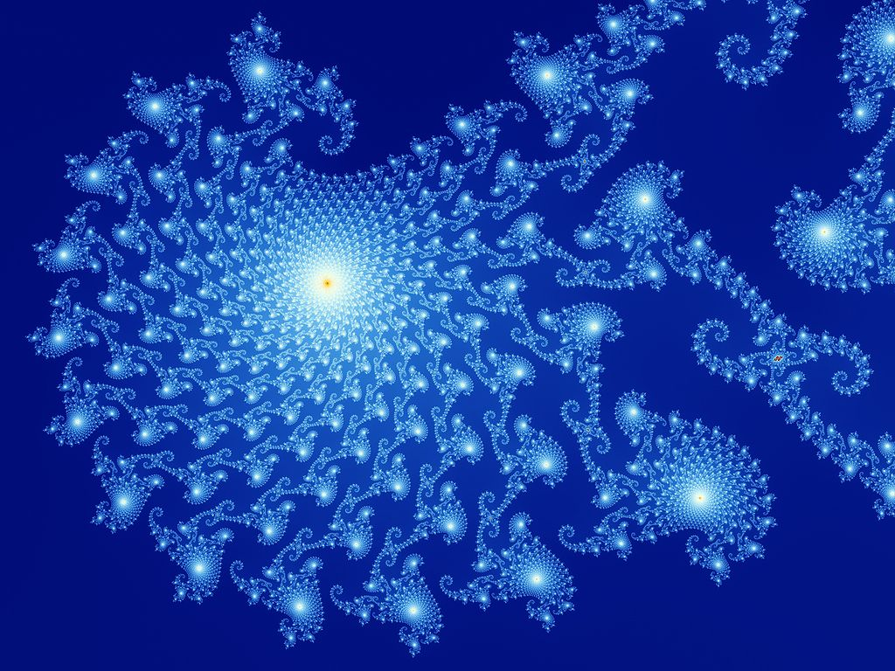

Slide 19


Slide 20
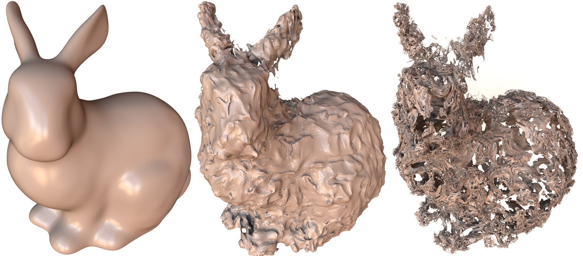

Slide 21
